Slide 1

Big Data Analytics Framework for NYC Green Taxi
Muhammad Nidzam| Analytics Vision

Slide 2
Executive Summary
The Market
Across the world has seen an explosion of growth of Big Data analytics over the last couple of years. Big Data applications and analytics is projected to grow from $5.3B in 2018 to $19.4B in 2026, attaining a CAGR of 15.49%. Big Data market worldwide includes Professional Services is projected to grow from $16.5B in 2018 to $21.3B in 2026. Due to explosion of data collection and data analytics, more company are moving to big data infrastructures such as moving their traditional database to Hadoop clustering and the usage of Spark to speed up Big Data analytics process. Due to our expertise in the field, NYC Green Taxi has request us to design and implement a Big Data Analytics framework for them.
Our Competitive Advantages
While there are currently many others company offering Big Data platform, we are the only few which specialize to help our customer to build big data analytics framework from infrastructure setup till the design of analytics user interface and visualization.
Our strategy is to emphasize the quality and competitive cost of service we provided. Help Desk services has also been setup to provide a 24x7 support to our customer to resolve any technical issues that may arise after product has been successfully deployed in our customer environment.
Our engineers are being trained and certified with the latest Big Data technologies especially in Hadoop and Spark.
All employees are insured and bonded.
Financial Projections
Based on the calculation we have done, we projected profit of $80000 for this project.
Financing Requirements
We are seeking an operating line of $150,000 to finance this project.

Slide 3
Project Description
Our customer, NYC Green Taxi is embarking on a Big Data transformation plan. We have been asked to help them in their journey by designing and implementing Big Data Analytics framework for the company

Slide 4
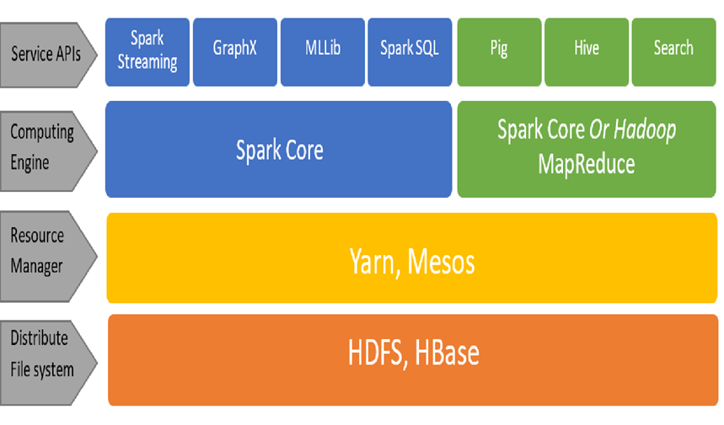
Proposed Big Data Framework
File storage system : Apache Hadoop
Computing engine : Apache Spark
Notes:
May require more than one slide

Slide 5
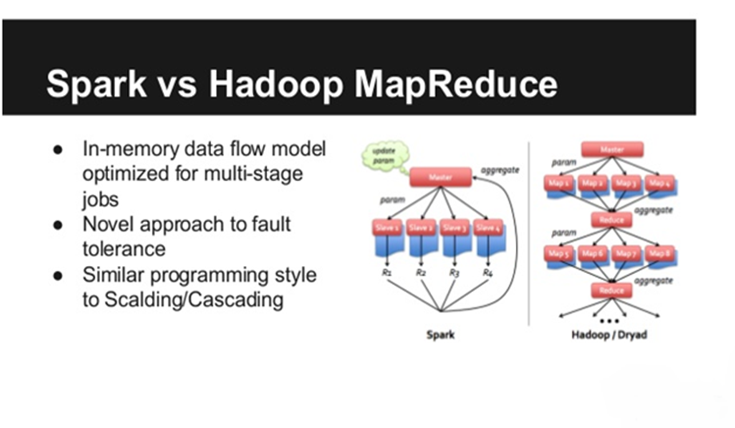
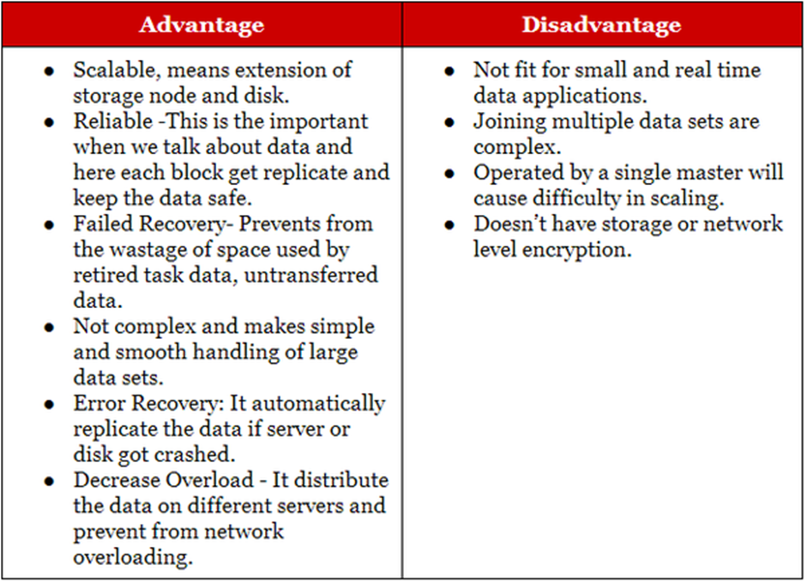
Hadoop Advantages\Disadvantages
Spark vs Hadoop MapReduce

Slide 6
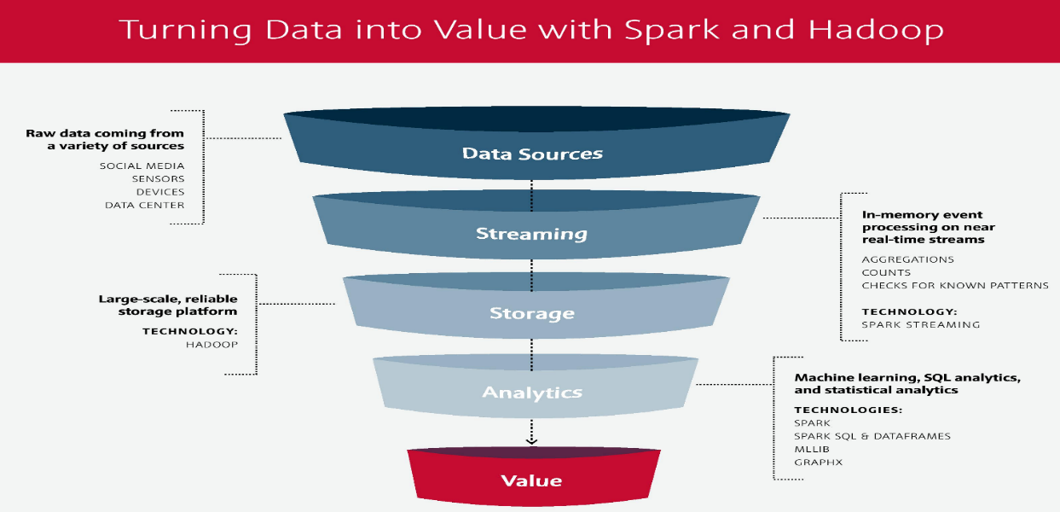
Data Analytics pipeline
Data from NYC Green Cab data provider vendor will be stream and stored inside Hadoop. For analytics purposes, Spark engine will be used to do calculations. Data then can be visualized using various visualization tools

Slide 7
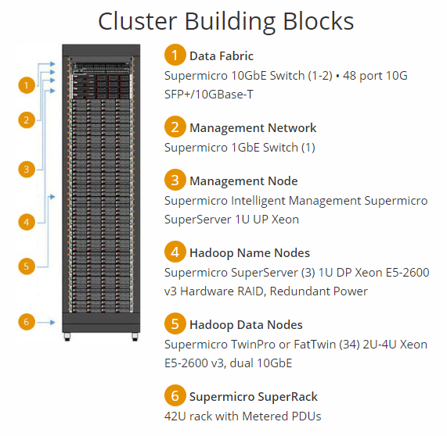
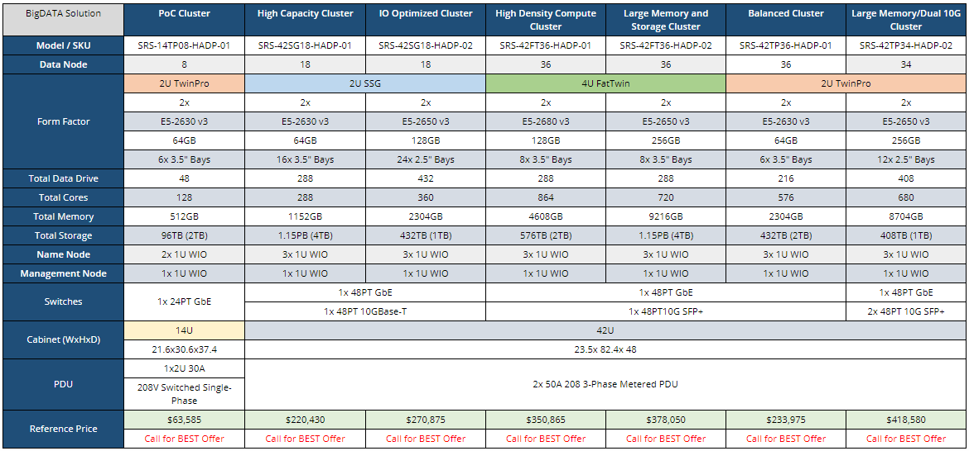
Hadoop Hardware
For this project, we are proposing to use server from Server Direct (https://www.serversdirect.com/)

Slide 8
Project Team Roles and Responsibilities
Project Manager
Administrative Assistant
Hadoop Developer
Hadoop Developer
Data Engineer

Slide 9
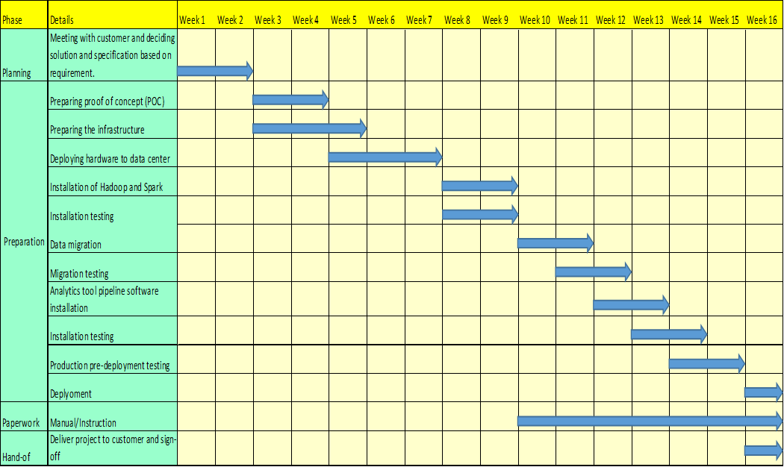
Timeline
For this project, we proposed a timeline of 4 month until deployment
Notes:
May require more than one slide

Slide 10
Proof of concept
To validate our framework concept, we installed a single node cluster of the framework into our test machine. The details of the installation as below
1) Java SDK JDK-8u191
2) Apache Hadoop-2.8.0
3) Apache Spark 2.4.0
4) Anaconda 3 (data analytics source control)
5) Python 3.6 (programming language for data processing)
6) Pyspark (python module for Spark)
7) Jupyter notebook (as python code editor)
For data analysis purposes, Green Taxi NY has provided us with the Green Taxi NY ride data for 2015. This dataset includes trip records from all trips completed in green taxis in NYC in 2015. Records include fields capturing pick-up and drop-off dates/times, pick-up and drop-off locations, trip distances, itemized fares, rate types, payment types, and driver-reported passenger counts. The data used in the attached datasets were collected and provided to the NYC Taxi and Limousine Commission (TLC) by technology providers authorized under the Livery Passenger Enhancement Program (LPEP). This data set contains 19.2M rows and 21 columns with the data total size of 3.2GB
The data set from here

Slide 11
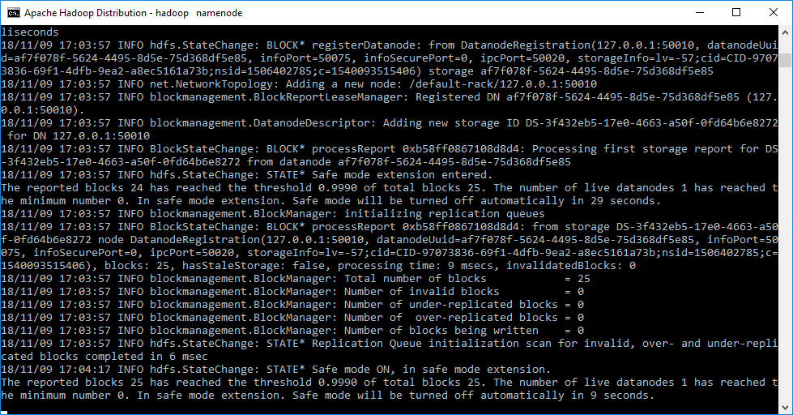
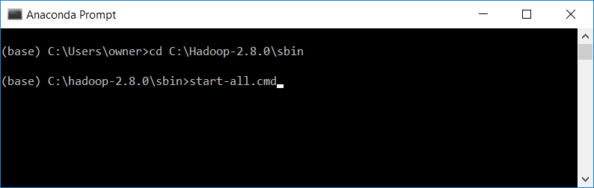
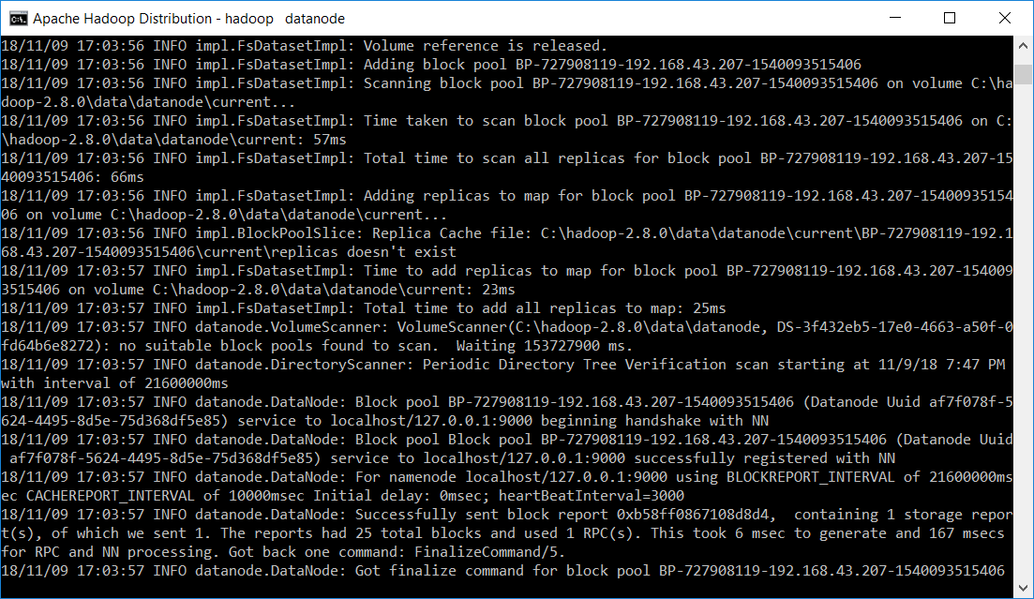
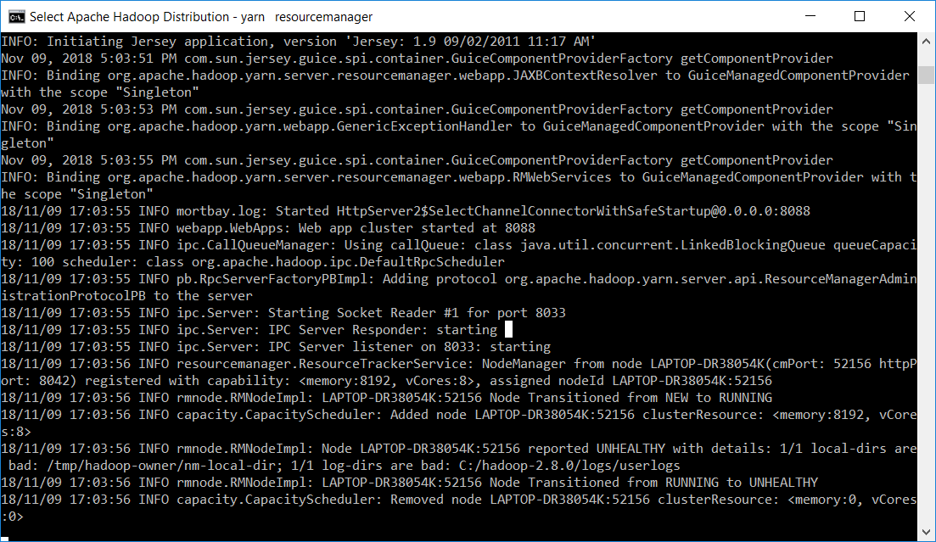
Run Hadoop on test machine
Namenode
Datanode
Node manager
Yarn resource manager

Slide 12
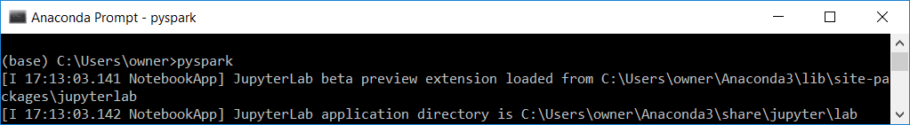
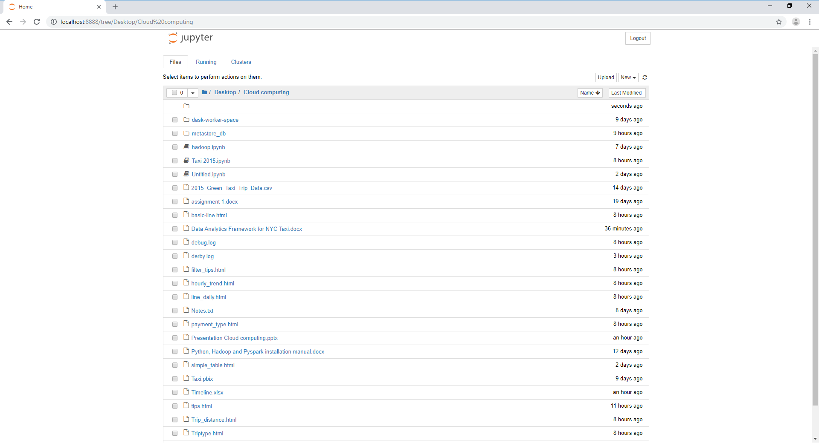
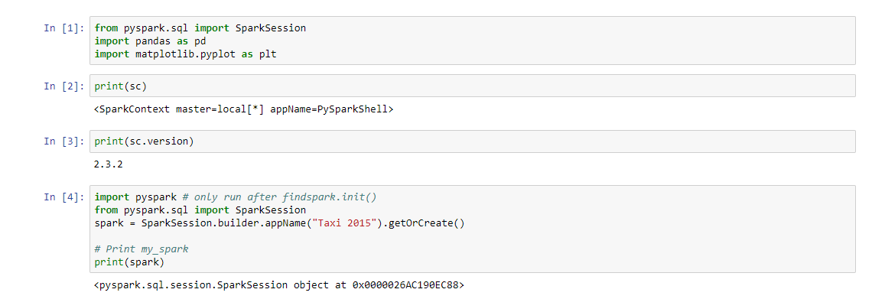
Run Spark and Jupyter Notebook on test machine
Run command to start Apache Spark server
Start Jupyter Notebook
Test spark connection from Jupyter Notebook

Slide 13
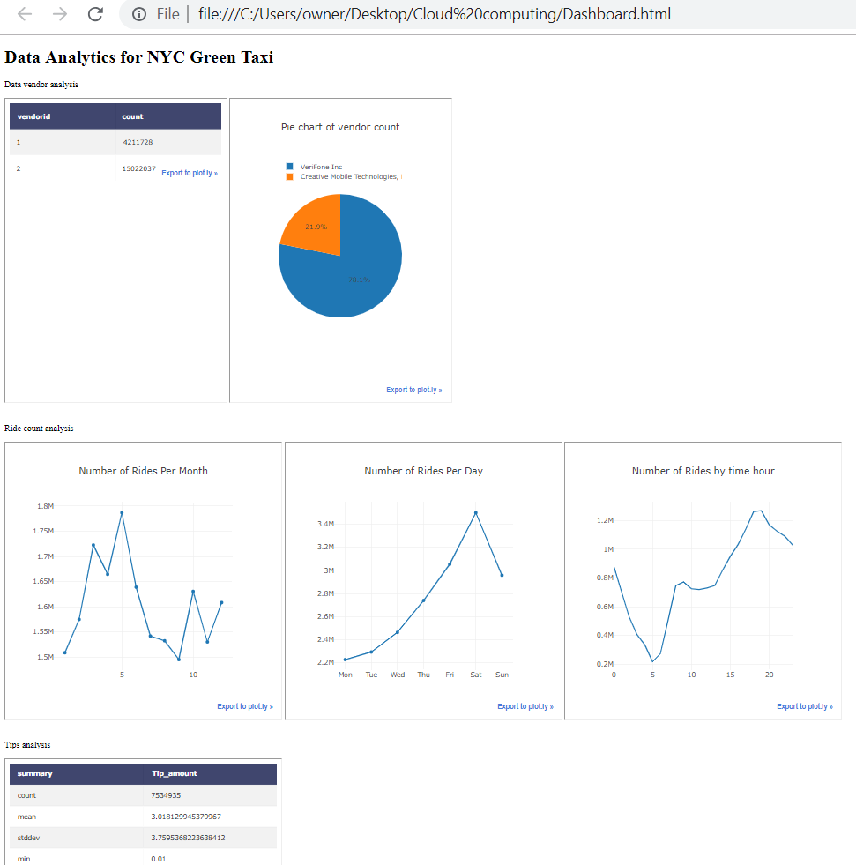
Dashboard for NYC Green Taxi
Dashboard for NYC Green Taxi

Slide 14
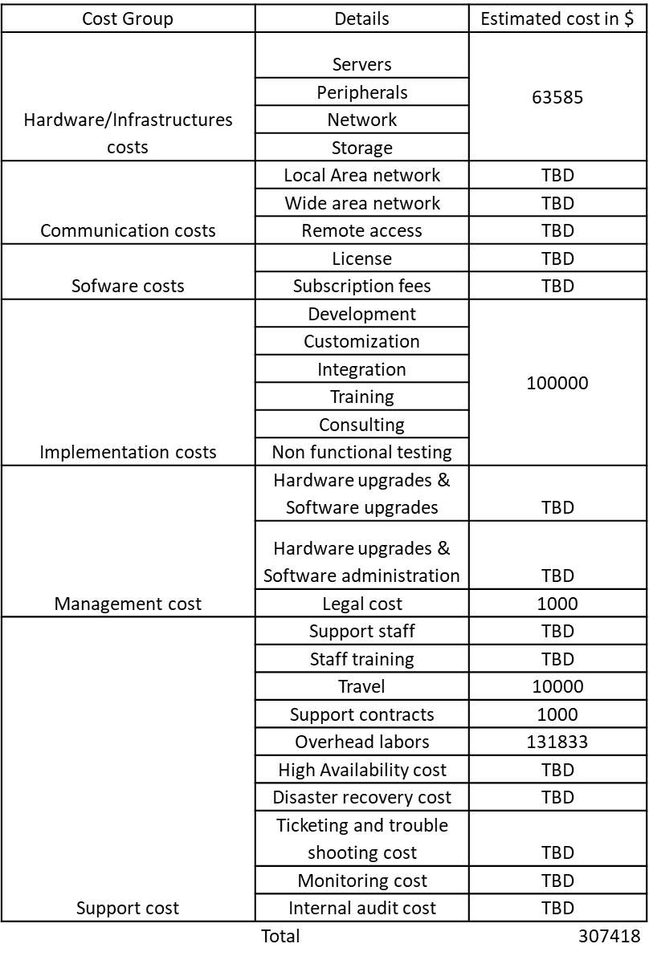
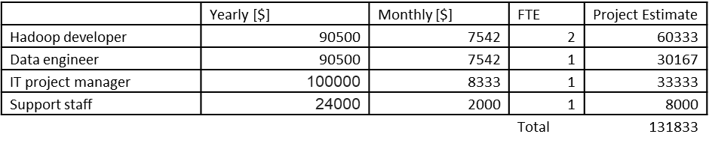
Cost Analysis
Total estimated cost for this project is $307418

Slide 15
Summary
In this report, we have explained the proposed framework that we are going to use for the project. We have also explained on the pro and con of the technology that we are going to use. A proof of concept model has been installed in our test machine and we successfully demonstrated on how Hadoop and Spark can be integrated. We also demonstrated on how data from Hadoop HDFS file can be connected to the analytics tool.
In term of costing, we found out the cost is very competitive and can be done below the budget allocated by NYC Green Taxi which is $400000. Therefore, in our opinion, the project is very viable and we requested a budget of $150000 to kick off the project upon agreement with NYC Green Taxi.

